Slide 1
Best Practices in Usage of RMC in Infra Projects
28th November 2018
Additional focus - Developments in Performance oriented Concrete
devendra.pandey@adityabirla.com
Notes:
Font for the entire presentation to be changed. The font must look big and bright. The aspect ratio of all our brand logos to be kept as per the original format.

Slide 2
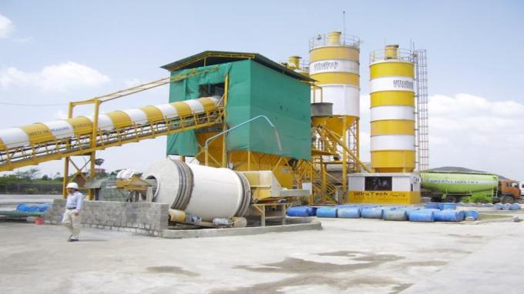
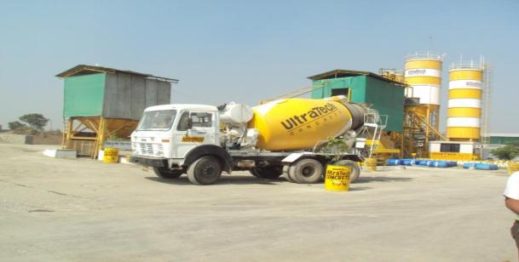
Ready Mixed Advantage for BETTER Concrete
Four legged approach
Produce better
Handle better
Protect better
Specify better

Slide 3
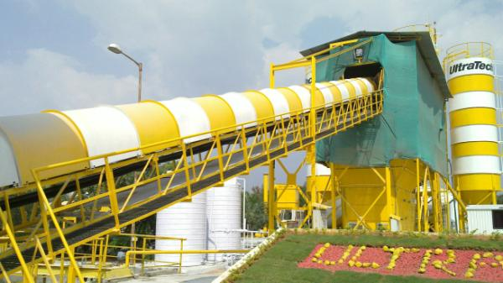

UltraTech RMC Plants
Chandigarh
Noida
Gurgaon
Jaipur
Lucknow
Ahmedabad
Bhopal
Rajkot
Indore
Raipur
Kolkata
Nasik
Nagpur
Mumbai
Pune
Hyderabad
Kolhapur
Vizag
Goa
Vijaywada
Mangalore
Tirupati
Bangalore
Mysore
Chennai
Cochin
Coimbatore
Notes:
Colour of the map to be of a darker shade. Back ground to be of our RMC plant to be used. Location icons to be of a brighter colour

Slide 4
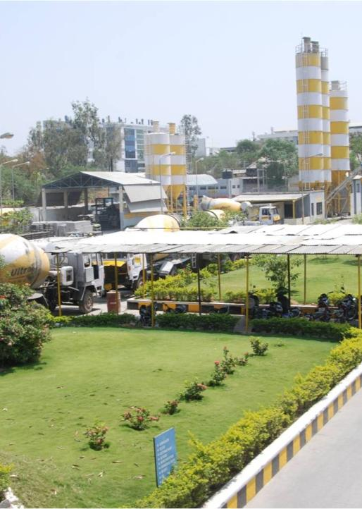



UltraTech Concrete With World Class Manufacturing
Quality Assurance and Control
Standardized processes to ensure quality production
Strong Quality Management Systems
Superior quality Control leveraging IT Systems
IT Systems
Production Management (SAP)
Quality Management (Labsys)
Outbound Logistics (Vehicle Tracking System/M Zone)
Integration with Finance Management (SAP)
World Class Manufacturing
A Blend of Superior IT Systems, Manpower, Quality assurance and control and customer focus has led us to this position of World Class Manufacturer
Notes:
UltraTech RMC plant image to be inserted

Slide 5











UltraTech Concrete Advantage
Mix Design: Flexibility in Design Methodology
Centralized Database: Concrete Strength
Raw Material Characteristic database and Analysis
QCI Certified RMC plants
Centralized Mix Approval
Assured Quality Always
Notes:
No change. Use RMC logo

Slide 6
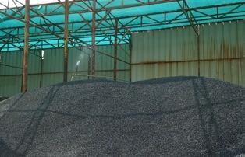
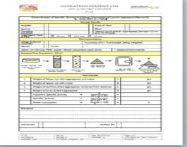

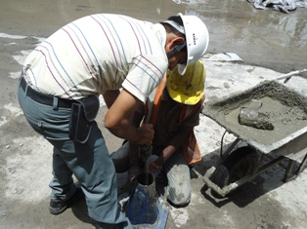
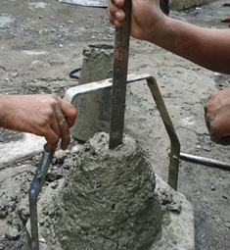
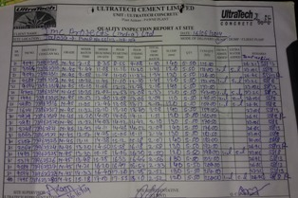
QC processes for consistent quality
Sourcing of the best quality raw material
Well documented and consistent raw material testing processes.
Centralized control of mix recipes integrated to the Batching system
Tests in the plant prior to dispatch of concrete to customers sites.
Testing of concrete at site prior to pumping / application.
Pour card to maintain traceability of concrete poured at site.

Slide 7
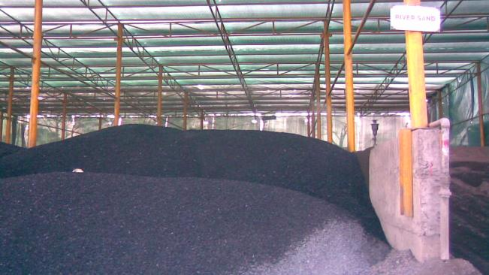
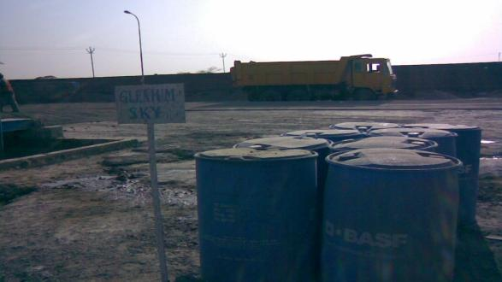
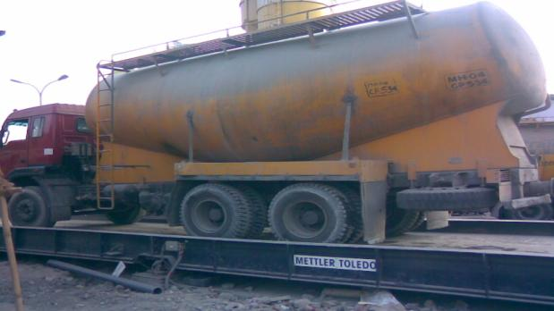
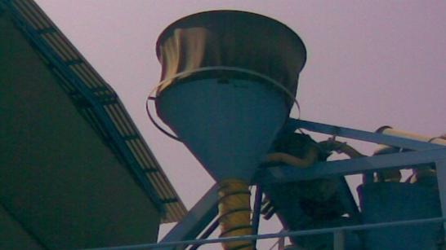

Slide 8

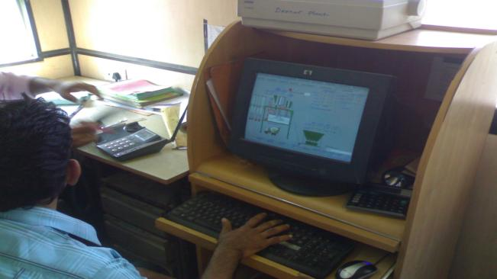
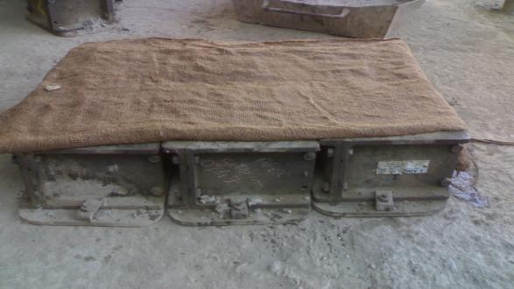
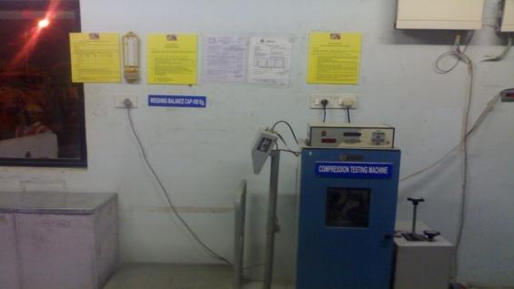

Slide 9
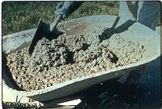
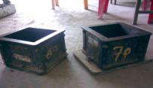
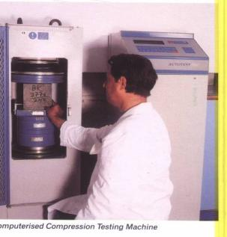

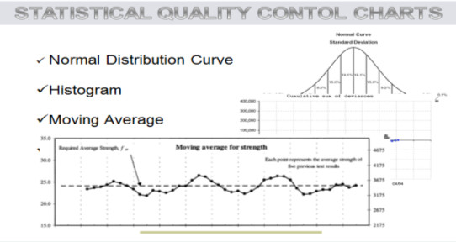
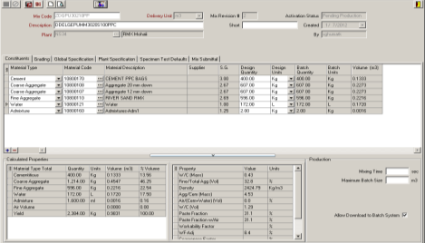
Hardened concrete testing processes
Proper sampling & mixing
Interfaced migration of data into LABSYS

Slide 10
Ready Mixed Advantage for BETTER Concrete
Four legged approach
Produce better
Handle better
Protect better
Specify better

Slide 11

Placing Concrete – Many methods!

Slide 12
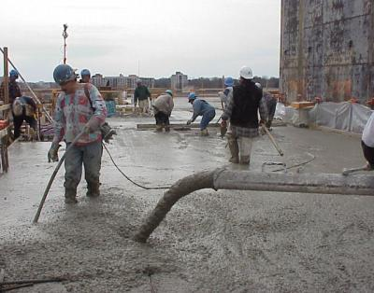
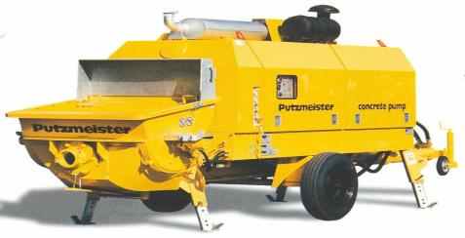
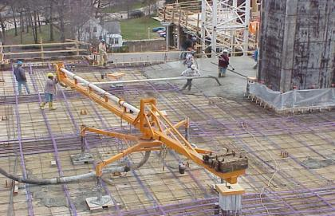
Concrete Pumping
Pump Placement
Ttransit mixer movement planning
Pump levelling
Minimum bends
Sturdy shuttering
Vertical clamping
Support manpower & equipment
Pour from extreme end

Slide 13

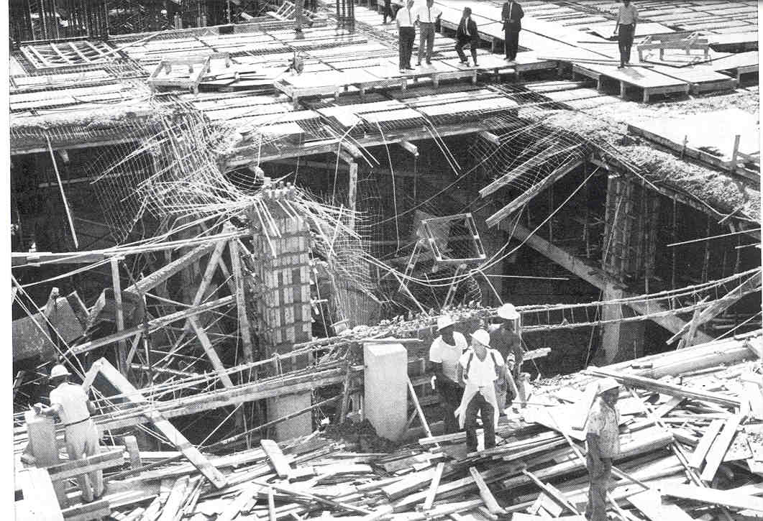
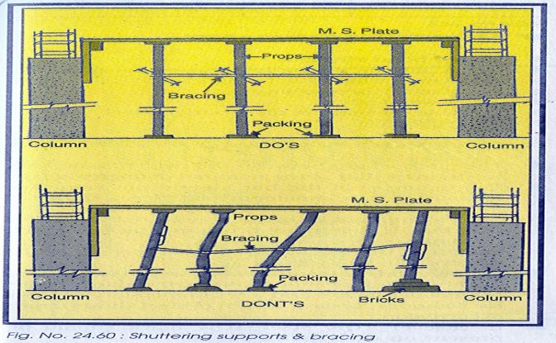
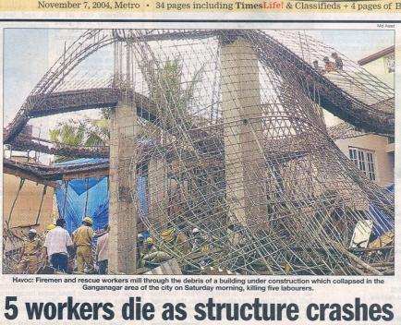

Slide 14
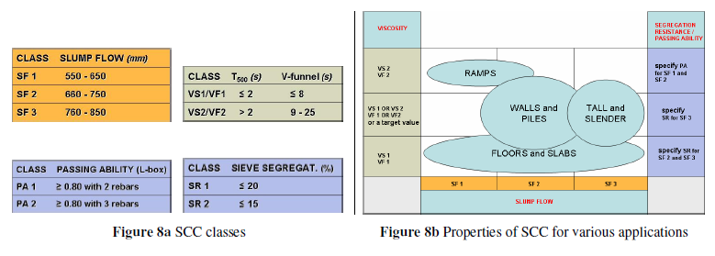
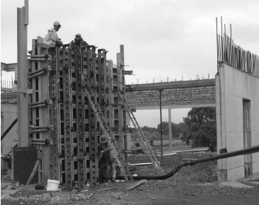
Workability works !!!

Slide 15
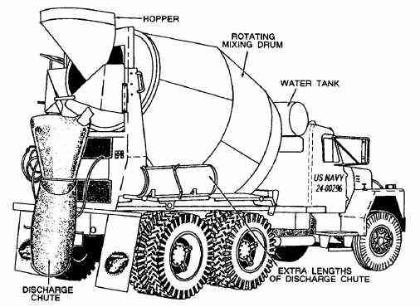

Re-tempering of RMC

Slide 16
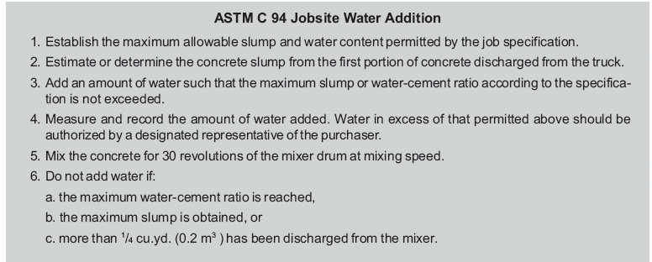
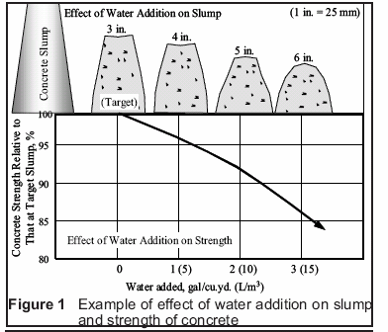
(Water+admixture)

Slide 17
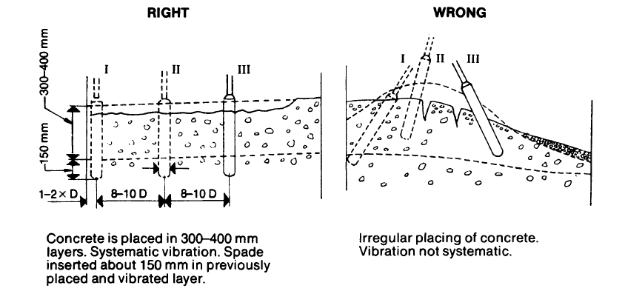
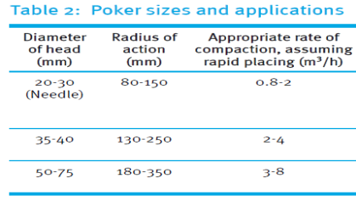
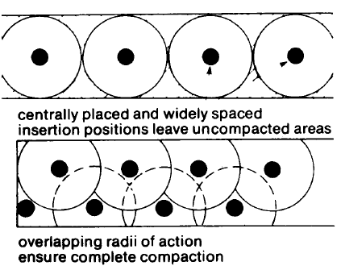
COMPACTION OF CONCRETE
  Consequences of entrapped air
    5% voids reduces ---- 30% strength of concrete
    10% voids reduce ---- 50% strength of concrete

Slide 18
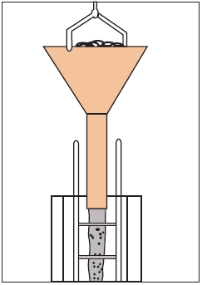
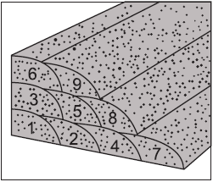

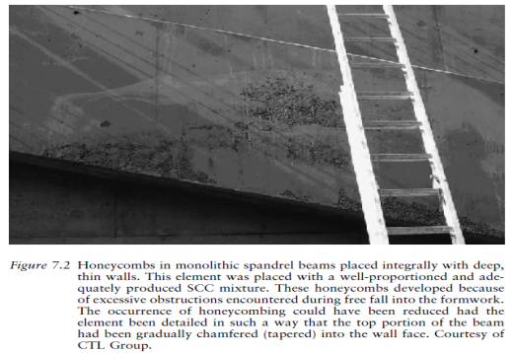

Slide 19
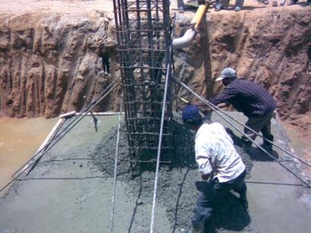
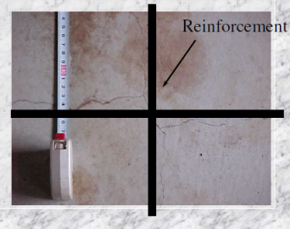

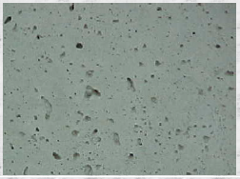

Slide 20
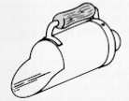
Sampling
!!! This is a very important issue !!!
SAMPLE THROUGH THE LOAD
“ Sampling and testing of concrete is an engineering art.”
Poor sampling and handling -- inconsistent and false results
Truly random basis
Instead of sampling concrete microscopically - ensure representative-ness
Remix thoroughly
AT LEAST 3 INCREAMENTS
REMIX
2 TESTS
AVERAGE

Slide 21
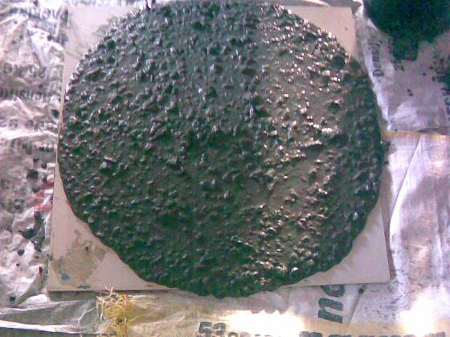
Point to Reflect : Slump or Workability??

Slide 22
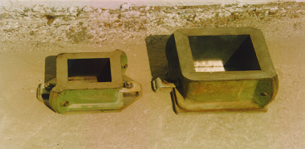
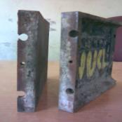


Definition of ‘Sample’
(Clause 6.3.2 of IS 4926-2003)
Is one cube a ‘sample’? …… NO!
Should we find an average of strengths from cubes of different samples? …… NO!
Should we take samples from every TM? …… NO! (1 every 50 Cum)
For reduced errors, cast more cubes from lesser samples

Slide 23
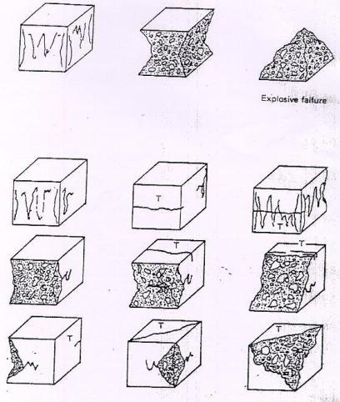
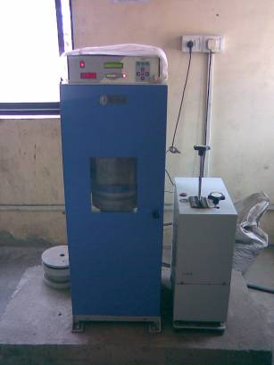
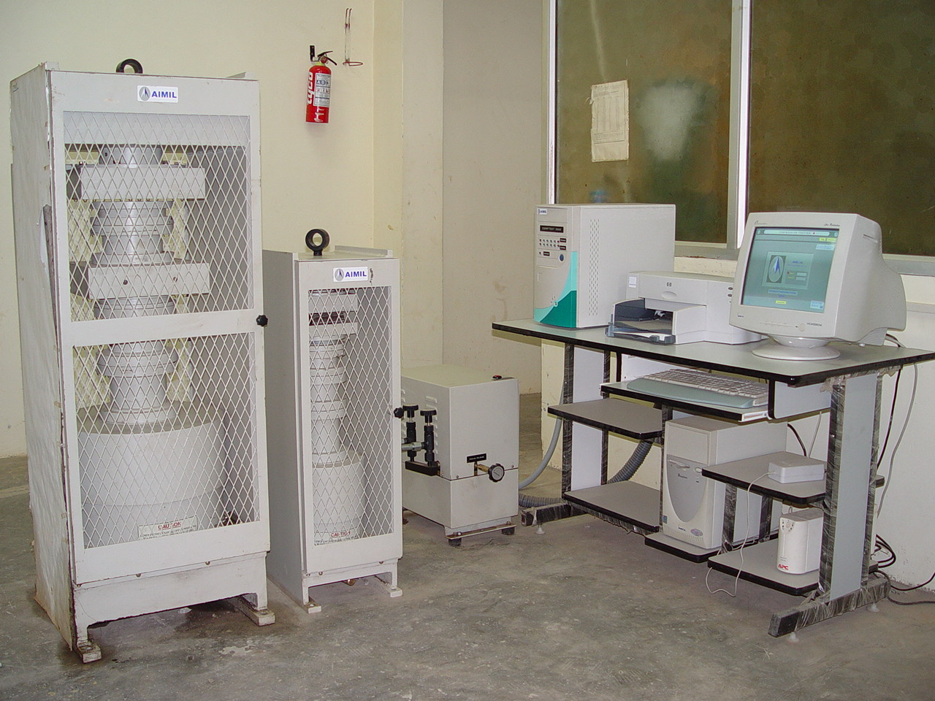
Testing compressive strength
Calibration
Bottom platen – horizontal, plane
Top platen – swivel
Do not place on casting faces
True failures
One sided or Abnormal failures

Slide 24

Cube Strength Failures
POOR CONCRETE ?
OR
POOR TESTING ?

Slide 25
TRUE AVERAGE CUBE STRENGTH OF
BATCH OF CONCRETE (BS 1881)
SAMPLING ERROR
FAILURE TO REMIX SAMPLE
DISTORTED CUBE MOULD; LACK OF
MOULD OIL
INCOMPLETE COMPACTION OF CONCRETE
CURING TEMPERATURE OUTSIDE
OF PERMITTED RANGE
LACK OF CONTINUOUS
MOIST CURING
FAULTY CUBE LOCATION IN MACHINE OR
OTHER OPERATOR FAULT
FAULTY TEST MACHINE
Strength of cube relative to true
average cube strength of batch of concrete
+10
-40
-30
-20
-10
0
%

Slide 26
Diagnostics – CBC count!
Unsymmetrical Failure Pattern
Variation in individual cube weights, strengths
Horizontal cracks / Cracks on top or bottom surface
Extreme variation in test results of cubes from the same sample
Poor repeatability / Vague results
% Variation

Slide 27
CORRECTIVE ACTIONS
Low average strength & High Standard Deviations
  Rework the design, Reevaluate the supplier
Medium average strengths (> Fck+3) & Low standard deviation
  No change, optimized concrete
Low average strengths (< Fck+3) & Low standard deviation
  Increase Cement content, reduce w/c
Low strengths coupled with unpredictable results & symptoms of testing errors
  Check testing equipment condition & calibration, Use trained manpower for sampling & testing
  No change in design, Verify tests done by RMC supplier
Low average strength & High within sample variation
  Discard lower results, find the average of remaining cubes
Two sets of extremely varying results – one passing, one failing
  Accept the high result & investigate the reason for discrepancy

Slide 28
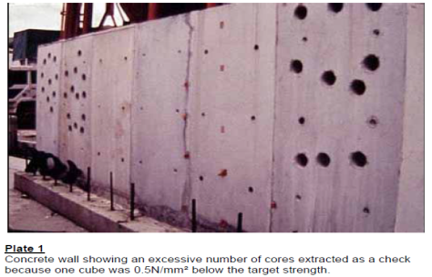
Quality Control - Macro
Statistical control and the variability – Standard Deviation
Recognition of testing errors, leading to discarding of low result
Attempt to ensure that no unsatisfactory concrete is produced rather than to try to detect individual unsatisfactory truckloads.
Recognition that the concrete supplier is in a far better position to control his concrete than the purchaser, leading to certification of suppliers instead of control of supplied concrete by purchaser - QCI

Slide 29
Ready Mixed Advantage for BETTER Concrete
Four legged approach
Produce better
Handle better
Protect better
Specify better

Slide 30
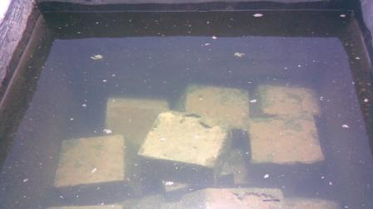

Slide 31


Slide 32



Slide 33
Theory of Plastic Shrinkage Cracking
TENSILE STRAIN CAPACITY
S
T
R
A
I
N
CONCRETE WITH FIBRES
SETTING
PERIOD
REGULAR RMC
RMC without
early protection
Well cured RMC
TIME
PLASTIC SHRINKAGE STRAIN

Slide 34







Please Protect the Baby

Slide 35



Prevention is the Real Cure

Slide 36
Ready Mixed Advantage for BETTER Concrete
Four legged approach
Produce better
Handle better
Protect better
Specify better

Slide 37


Are all plants same as RMC?

Slide 38
Some queries to resolve!
What about NDT or core tests?
  More chances of error than cubes !
Can we prescribe our own mix design?
  Uneconomical & no performance guarantee
Does fly ash / GGBS addition mean inferior or cheaper concrete?
  Do we spend more to have a longer life? DURABILITY !

Slide 39






UltraTech Concrete
Key Processes
Made to Order
Batching
Scheduling
Raw Material Characteristic database and Analysis
Mix Design: Flexibility in Design Methodology
Online Design mix development and analysis
Mix Design
Tracking
Centralized Mix Design Approval

Slide 40










Site Based Activities
Training programmes on cement & concrete technology for site Managers & Engineers
Assistance on regular field construction related queries.
Field Demo & Guidance on Good Construction Practices.
Training of Quality Control Team / Lab Technicians on cement testing by our experienced plant Q/C personnel
Training of QC team / Lab team on concrete testing
Notes:
Attractive font to be used

Slide 41

















UltraTech Specialty Concrete Offerings
Notes:
Logos to be as per our brand guidelines. Logo to be used from artwork files

Slide 42
UltraTech Specialty Concrete Offerings
Notes:
Logos to be as per our brand guidelines. Logo to be used from artwork files

Slide 43




A Self Compacting Concrete designed to flow freely irrespective of the dense reinforcement and complexity of the structure
M60 Freeflow in deck slab of Cable Stayed Bridge for Mumbai Metro over Western Express Highway
Notes:
Slides to be formatted

Slide 44



A special high performance concrete designed for slender structure which bear heavy loads
Mumbai Metro
Average Strength-80 MPa
Standard Deviation- 4 MPa
Notes:
Slides to be formatted

Slide 45



Mumbai Mono Rail
  Avg. RCPT Value- 900Coulombs @ 28 days
  Permeability- 10 mm @ 28 days
Chennai Metro
  Avg. RCPT Value- 750 Coulombs @ 28 days
  Permeability- 8-9 mm @ 28 days
A specially designed High Performance Concrete for extra durable structures
Notes:
Slides to be formatted. Mumbai Mono rail to be 1st

Slide 46


Crystalline waterproofing for freedom from dampness

Slide 47






Light Weight Concrete for Insulating walls and fills
Lite is light weight concrete which is 50-75% lighter than normal concrete. It has
thermal insulating properties & sound insulation. It has improved thermal properties,
reduced structural loading and fire resistant.
Standard Concrete Specification:-
Strength class | 1-25 MPa
Viscosity | Low
Slump | 120 – 200mm
Segregation resistance | High
Density | 650 kg/m3 & above

Slide 48




Stamped Concrete for Landscaping
Decor is a range of concrete to be printed or stamped for making decorative surfaces on porch, paving. It can be designed from M25 to M35 MPa compressive strength at 28 days as per the requirement. Higher grades are also available if required. The aesthetic results are achieved by affixing moulds or stencils on fresh concrete surface phase curing. The final appearance resembles that of natural materials such as stone and wood.
Standard Concrete Specification:-
Strength class | 25 – 35 MPa
Workability | Can be designed as per the requirement

Slide 49



Bucket Concrete for small usages, repair work
Bucket concrete is the normal concrete (M15 to M35 grade) delivered in 15/10 litres bucket at the site or picked up at any of our plants. It can be transported on any vehicle.
Strength class | 5 – 40 MPa
Workability | Can be designed as per the requirement

Slide 50




















Glimpse Of Our Valued Customers

Slide 51


Thank You !

